Slide 1
Project Presentation and Demonstration
Team Name: COS10025 - 09
Group no: 09
Members:

Slide 2
Overview

Slide 3
Project Background

Slide 4
Project Scope

Slide 5
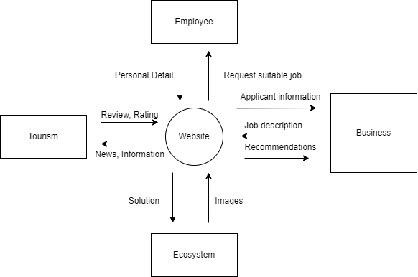
Design idea/concept 1
Data Flow Diagram Level 0
Learning issue/problem
Vung tau city face several challenges after Covid-19:
Ecosystem
Tourism experience
Insufficient Employee
Business recovery
Used Technology:
Next Js (JavaScript framework for full stack development)
Tailwind CSS (CSS framework)
Firebase (database)
Thanh Minh
Notes:
Throughout my research, I found that the city of Vung Tau in Vietnam faces several challenges after the pandemic related to its ecosystem, tourism, employee and business recovery. To address these issues effectively, we propose the use of digital solutions powered by NextJS (JavaScript framework for full-stack development ,Tailwind CSS, MySQL. This presentation presents my design idea and concept to tackle the identified learning issues and problems. Tourism plays a vital role in Vung Tau's economy. To enhance the tourism experience and attract more visitors, our design ideas focus on leveraging digital solutions.

Slide 6
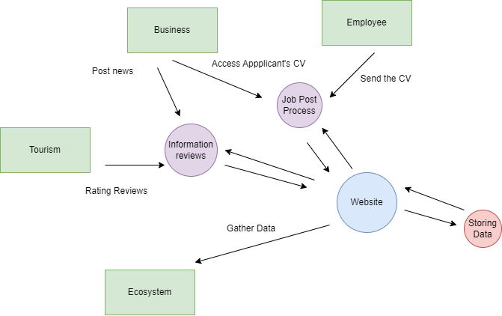
Design idea/concept 1
Design outline
DFD level 1
Home Page: Landing page to highlight scenes
Attraction Section: Showcasing the city’s attractions
Pollution section: Where scenes are compared
Activities and Events: Calendar of upcoming events
Local Insights: highlight experience
Travel Tips: Practical advice for visitors
Thanh Minh
Notes:
For the design outline, the landing page will highlight the scenes and captures the attention of visitors. The attractions section showcasing the city’s key attractions, including beaches and historical landmarks, natural wonders. Detailed information, images, and visitor reviews will be provided to assist tourists in planning. Pollution section is where all the compared images will be shown to the tourists before and after pollution. Activities and events will show a calendar of upcoming events, festivals and activities taking place in the city. Local insights are personalized recommendations from locals, highlighting hidden gems and lesser-known experience. Travel tip is a section to display the practical advice for visitors including transportation options, cultural etiquette.

Slide 7
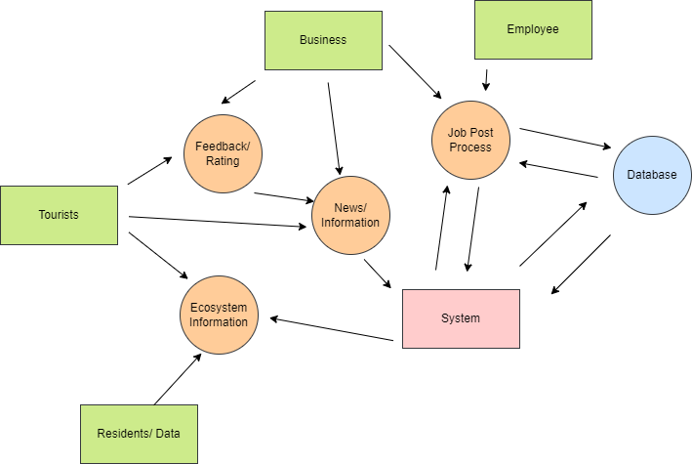
Design idea/concept 1
DFD level 2
Benefits of Technology
SEO (Next JS – Server-Side Rendering)
Lightweight Web Application (Next JS , Tailwind)
Ease to use with good documentation (Fire Base)
Real Time (Fire Base)
Security (Next JS – libraries and Fire Base Authentication)
Thanh Minh
Notes:
The first benefit is SEO which stand for Search engine optimization is the process of improving the ranking of a website in search engine results pages which is Next Js built-in, allow the server-side rendering. Next Js also have built-in features such as Lazy Loading, … allow the contents of websites become light-weight. And Tailwind CSS is well-known for its lightweight feature. Fire Base is a cloud-based platform that provides a number of services for web development including authentication, real-time data and hosting. Fire Base ‘s documentation is well-written and easy to follow, making easy for developers to get started with the platform. The users can interact with the application in real time. Security a critical issue for web applications, but with Fire Base, it provides a number of security features such as authentication, authorization and data encryption so as Next Js

Slide 8
Design idea/concept 1
Benefits
Access and Equity
Appropriateness
Affordability
Environmental Health
Sustainable Livelihoods
Estimation of the design budget
Technology | Cost
Web Development Technology (Front End) | $3,000 - $7,000
Back End (Staff, technology) | At least $5,000
Firebase | Pay as go ($0.12/GB)
Digital Marketing | $4,000 - $7,000
Total cost (Minimum): $12,100 -$19,100
Thanh Minh
Notes:
For the first benefit, this idea provide interactive website and promote the equal access to information and opportunities for all residents and businesses. For the second benefit, this design idea consider specific needs and characteristics, we tailor the digital solutions to suit the local context. Then, What I mean for the affordability is we propose aim to be cost effective and accessible to businesses, minimize development costs. By addressing ecosystem problems and promoting sustainable practices through campaign, images collected from local areas. This idea also target to create a thriving marketplace that benefits both businesses and residents by connecting the unemployed people and businesses. I have asked some lecturers from Media department, and they said that normally the marketing will account for about $4000 - $7000 minimum. I estimate the system will account for about $3000 - $7000 including the maintenance and fix error occurs. For the Database, I will use the plan pay as go and account $0.12/ GB.

Slide 9
Design idea/concept 2
Learning issue/problem

Slide 10
Design idea/concept 2
Design outline

Slide 11
Design idea/concept 2
Design benefits

Slide 12
Design idea/concept 2
Estimation of the design budget

Slide 13
Design idea/concept 3
Learning issue/problem

Slide 14
Design idea/concept 3
Design outline

Slide 15
Design idea/concept 3
Design benefits

Slide 16
Design idea/concept 3
Estimation of the design budget

Slide 17
Thank you

